Slide 1

SCIENCE VISUALIZATIONS
https://github.com/zmlabe/ClimatePython
PALETTABLE CUBEHELIX

Slide 2
RESOURCES
1. https://betterfigures.org/ 2. https://www.climate-lab-book.ac.uk/ 3. http://colorbrewer2.org/

Slide 3
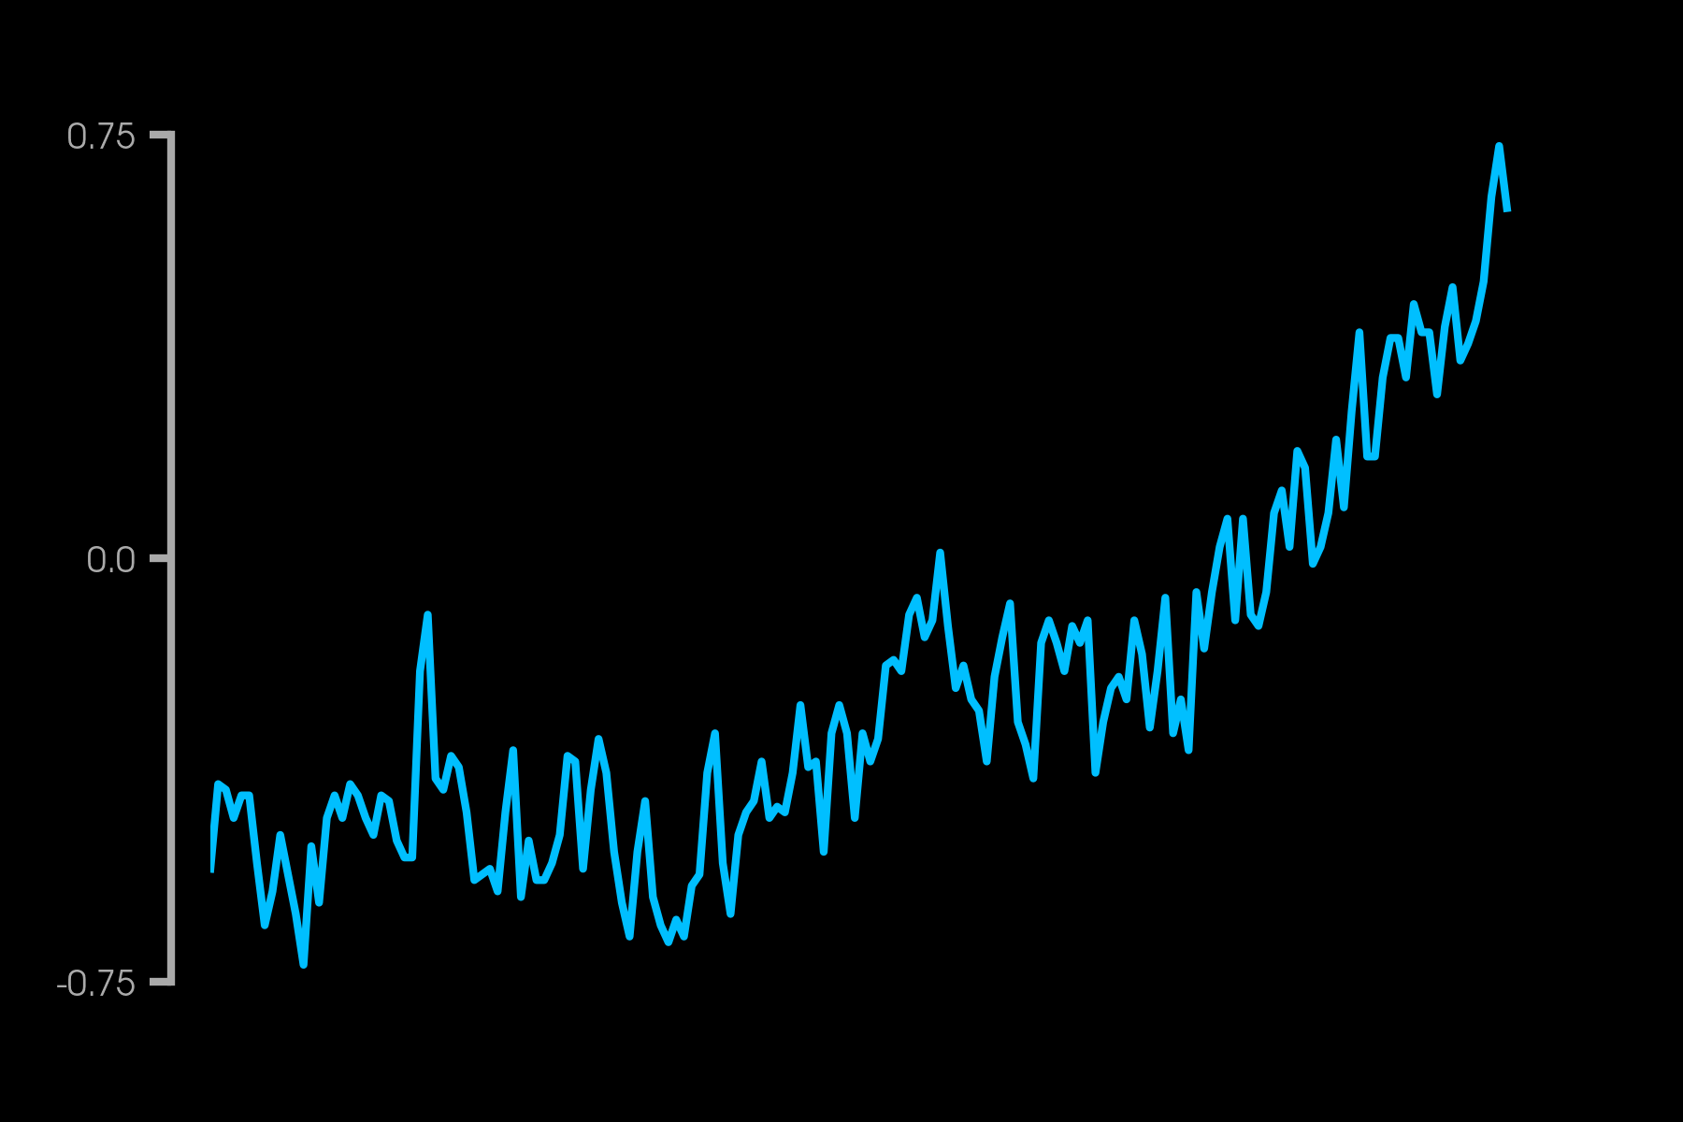
LINE GRAPHS
Temperature Anomaly (°C)

Slide 4
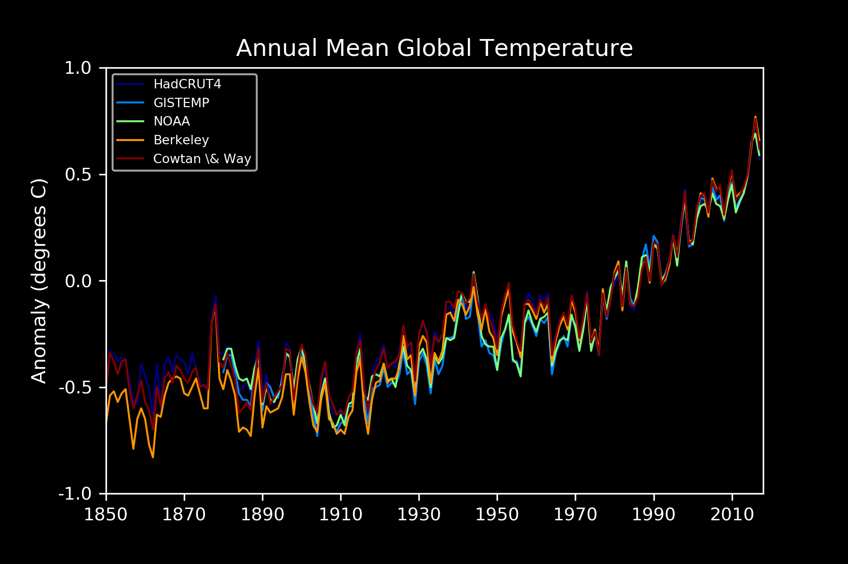

Slide 5
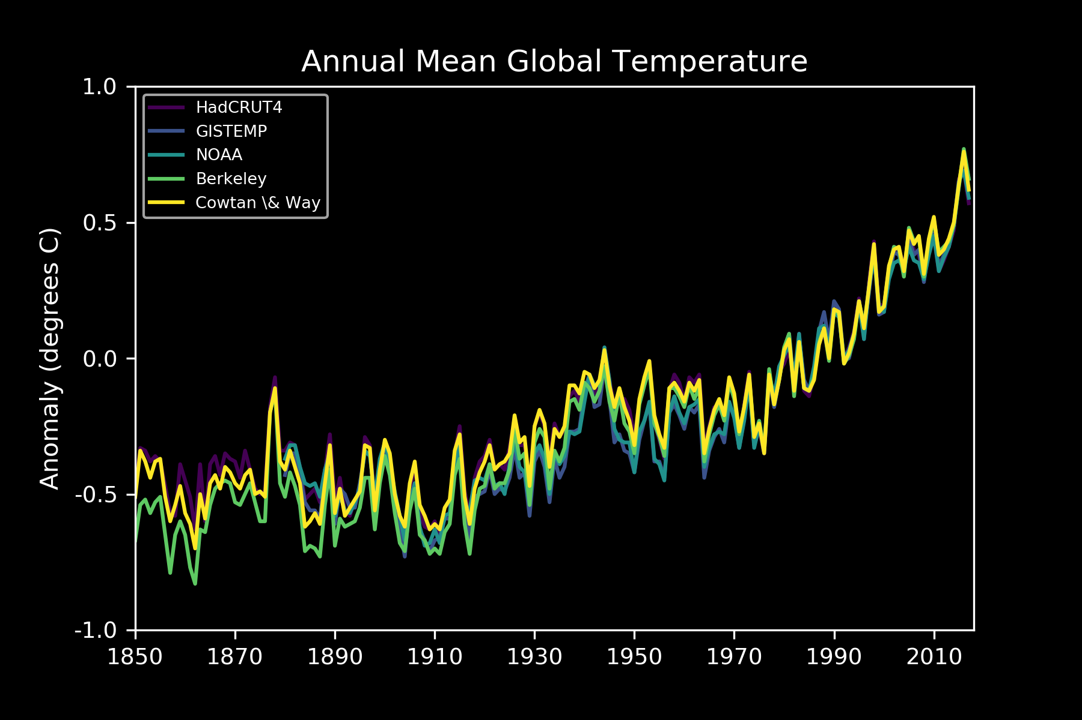

Slide 6
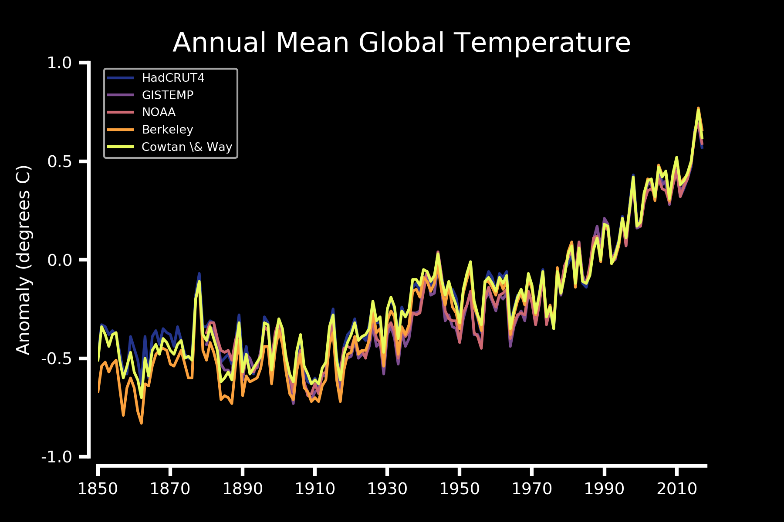

Slide 7
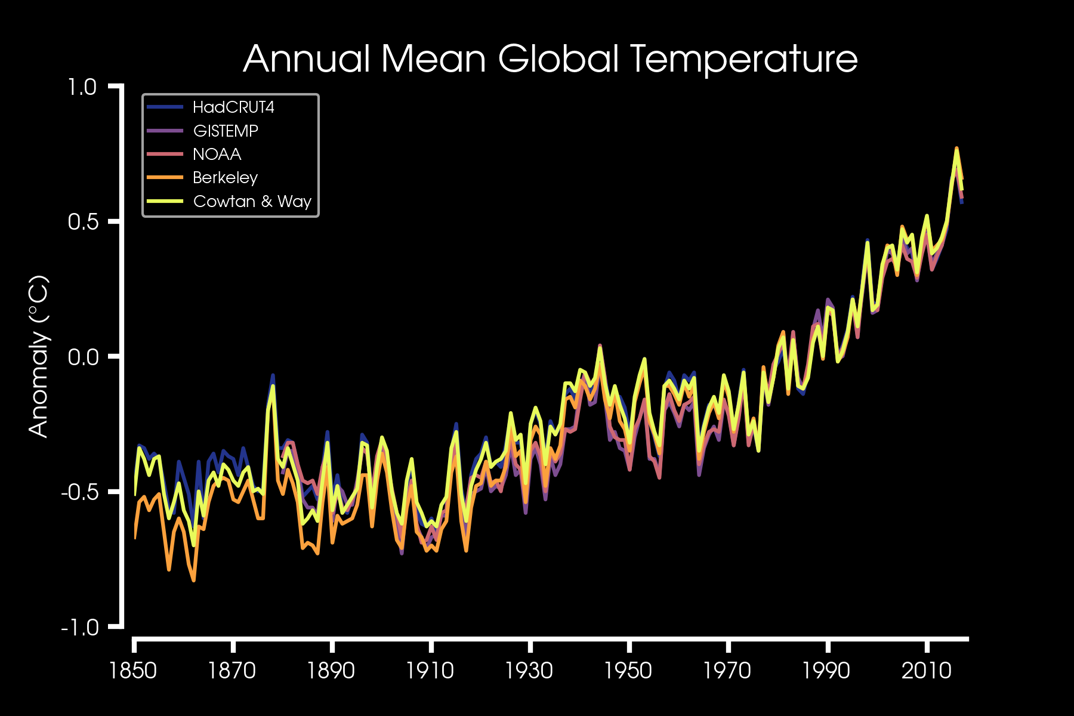

Slide 8
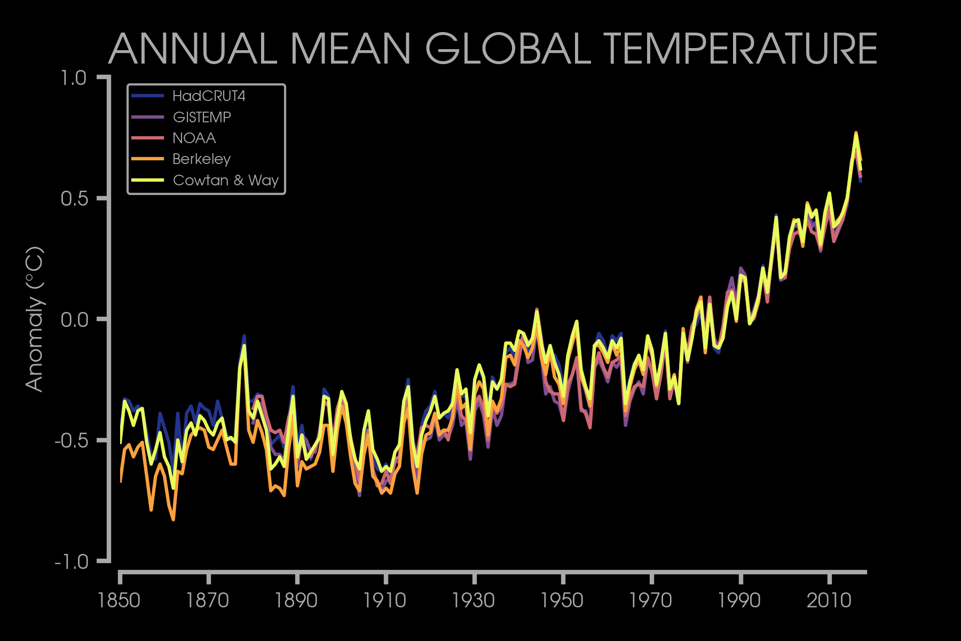

Slide 9
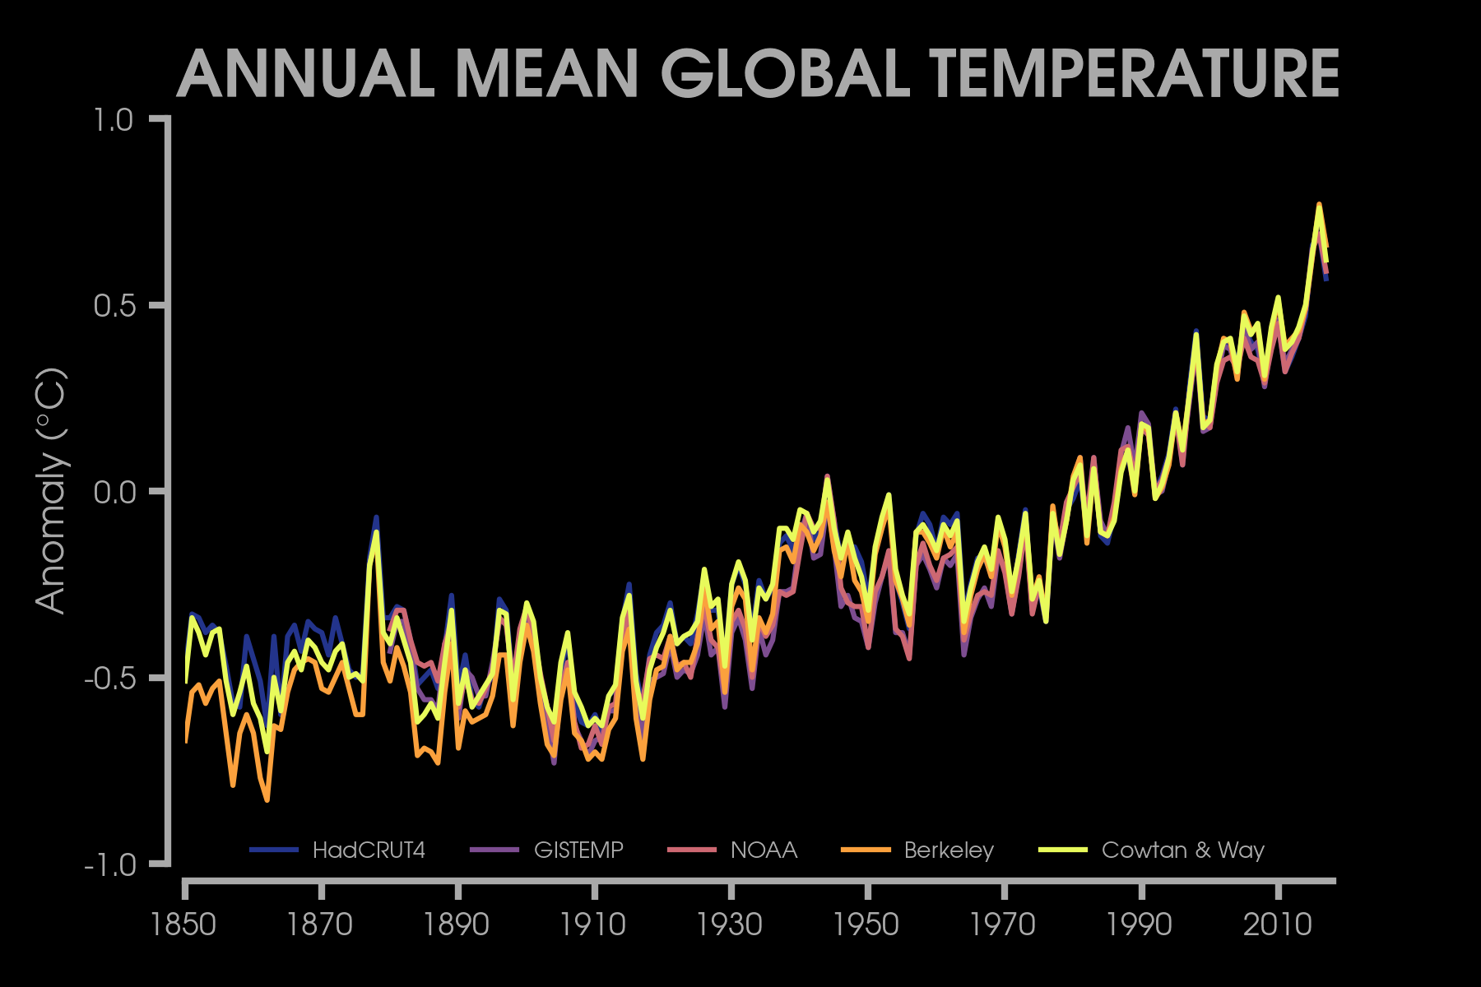
:)

Slide 10
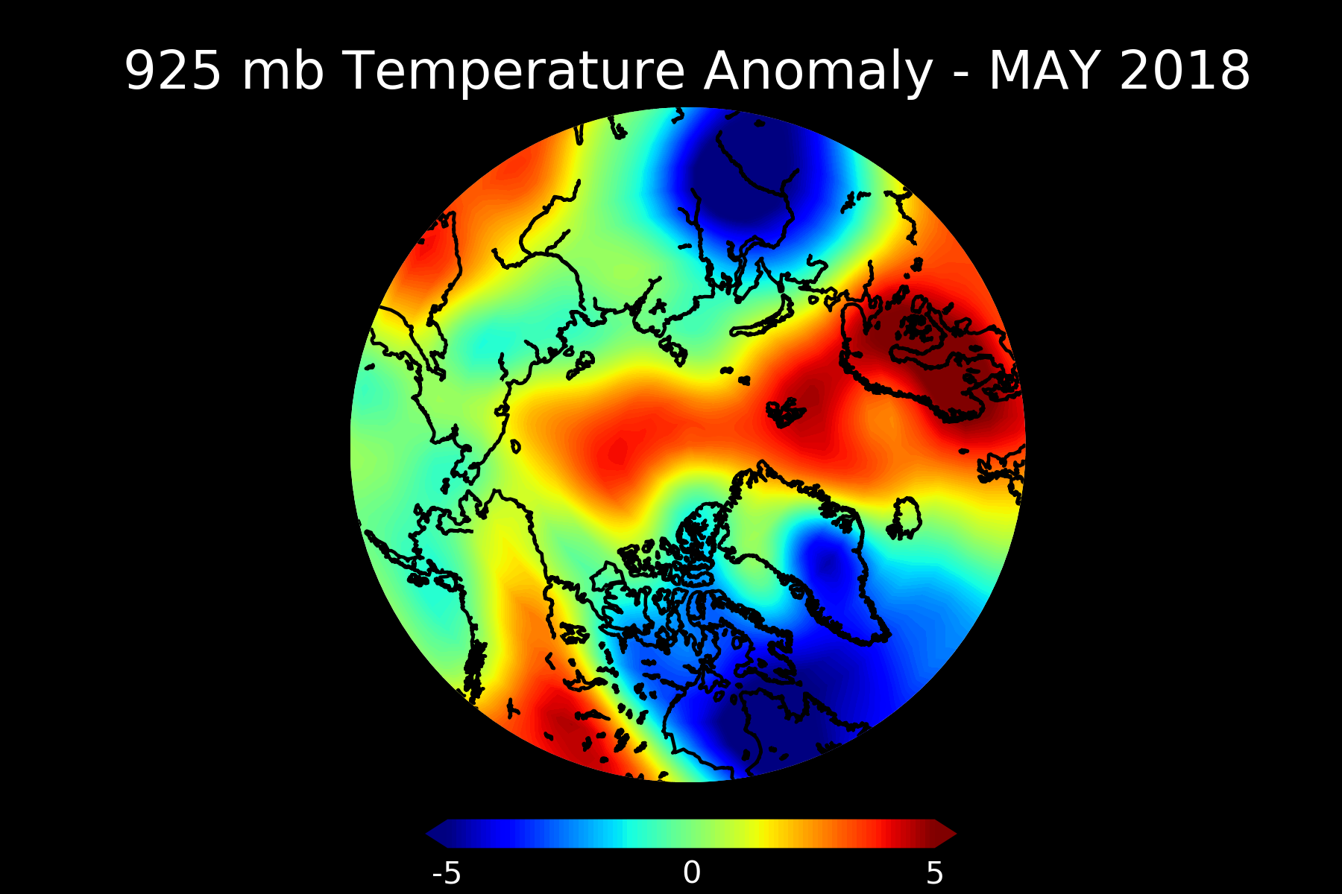
MAP PLOTS

Slide 11
YIKES – COLOR!

Slide 12
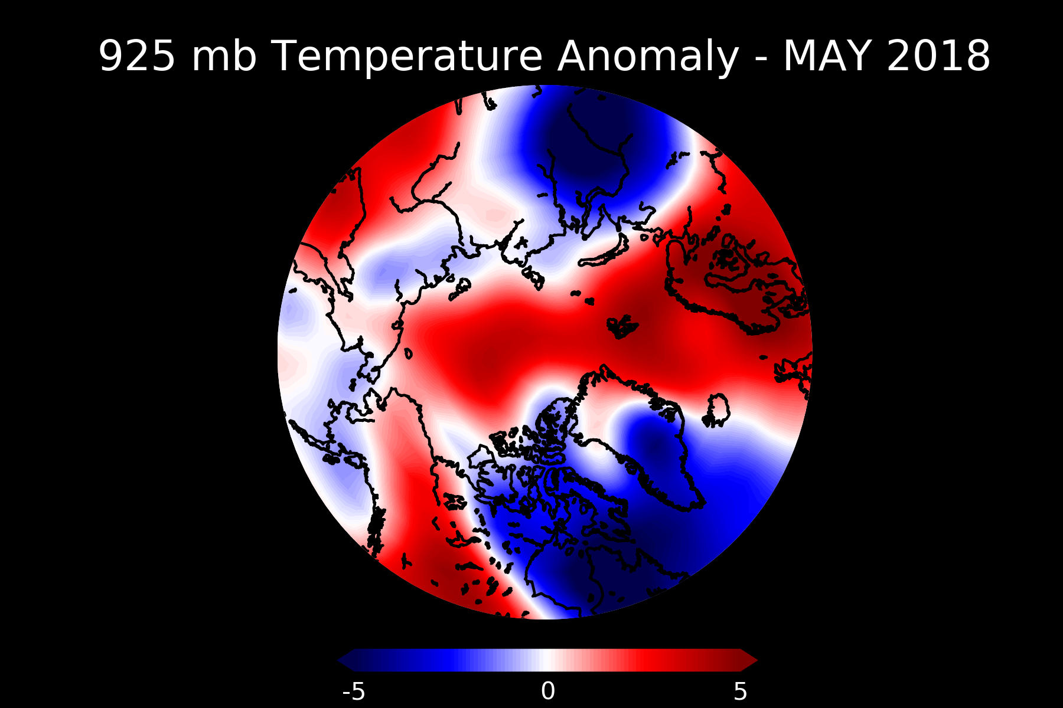
YIKES – THE FONT!

Slide 13
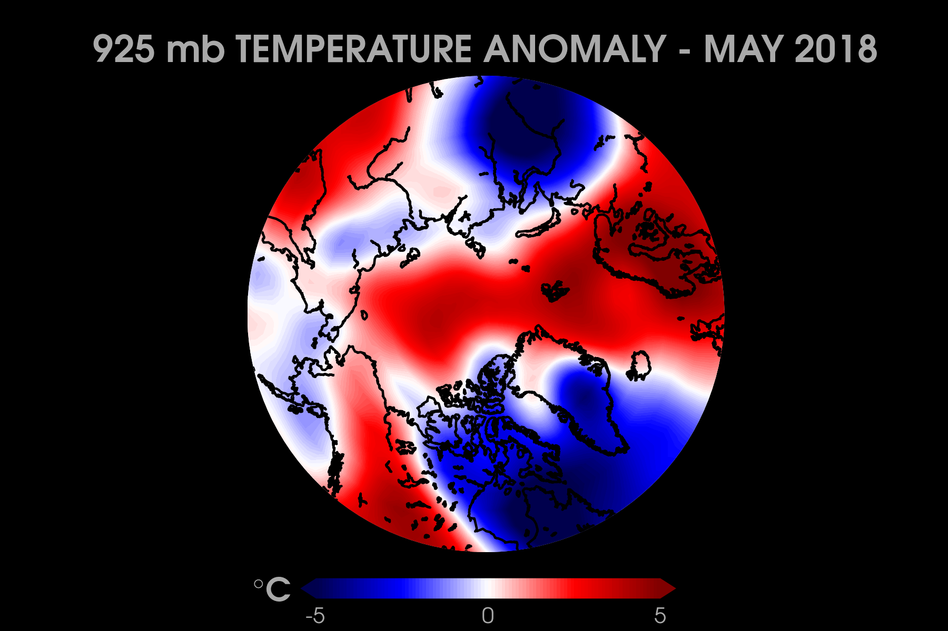
YIKES – SOFTEN COASTLINES!

Slide 14
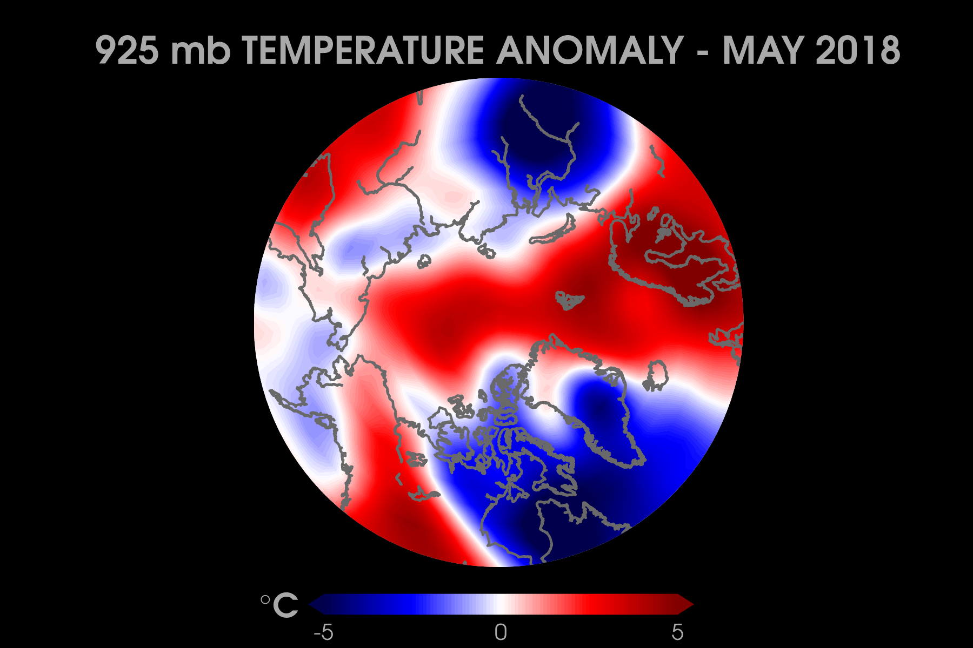
YIKES – FIRE IN THE ARCTIC!

Slide 15
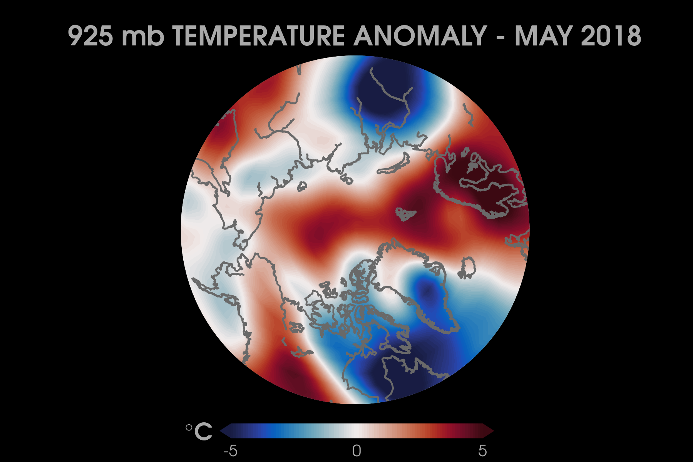
OKAY – MINOR DETAILS

Slide 16
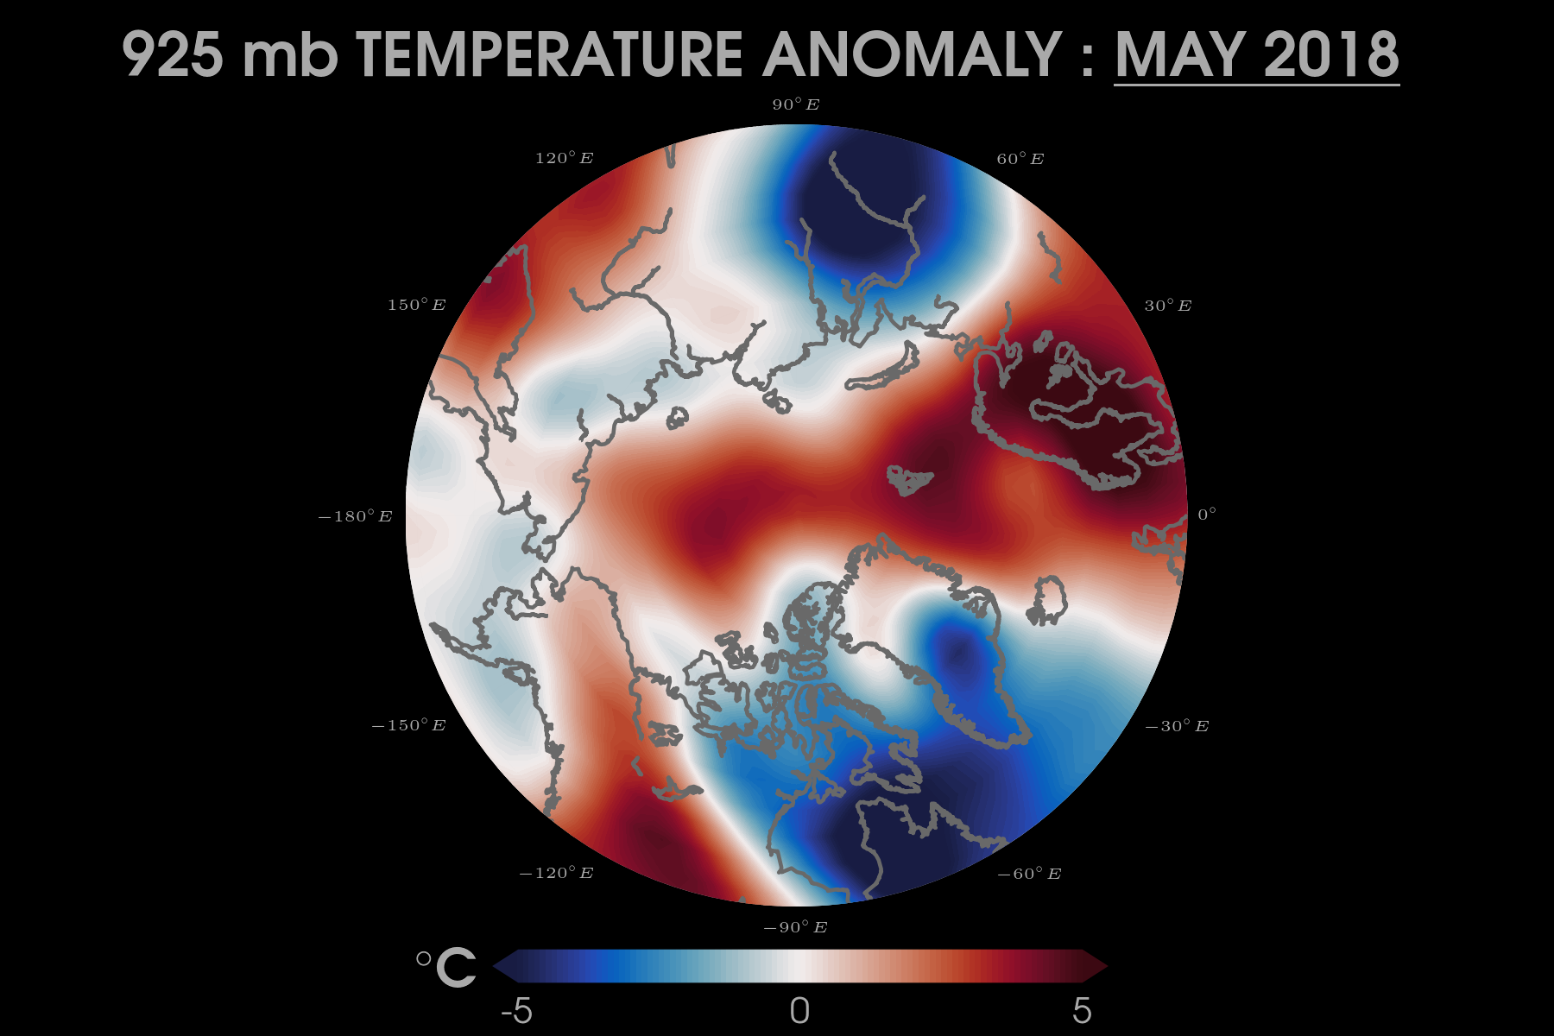
:)

Slide 17
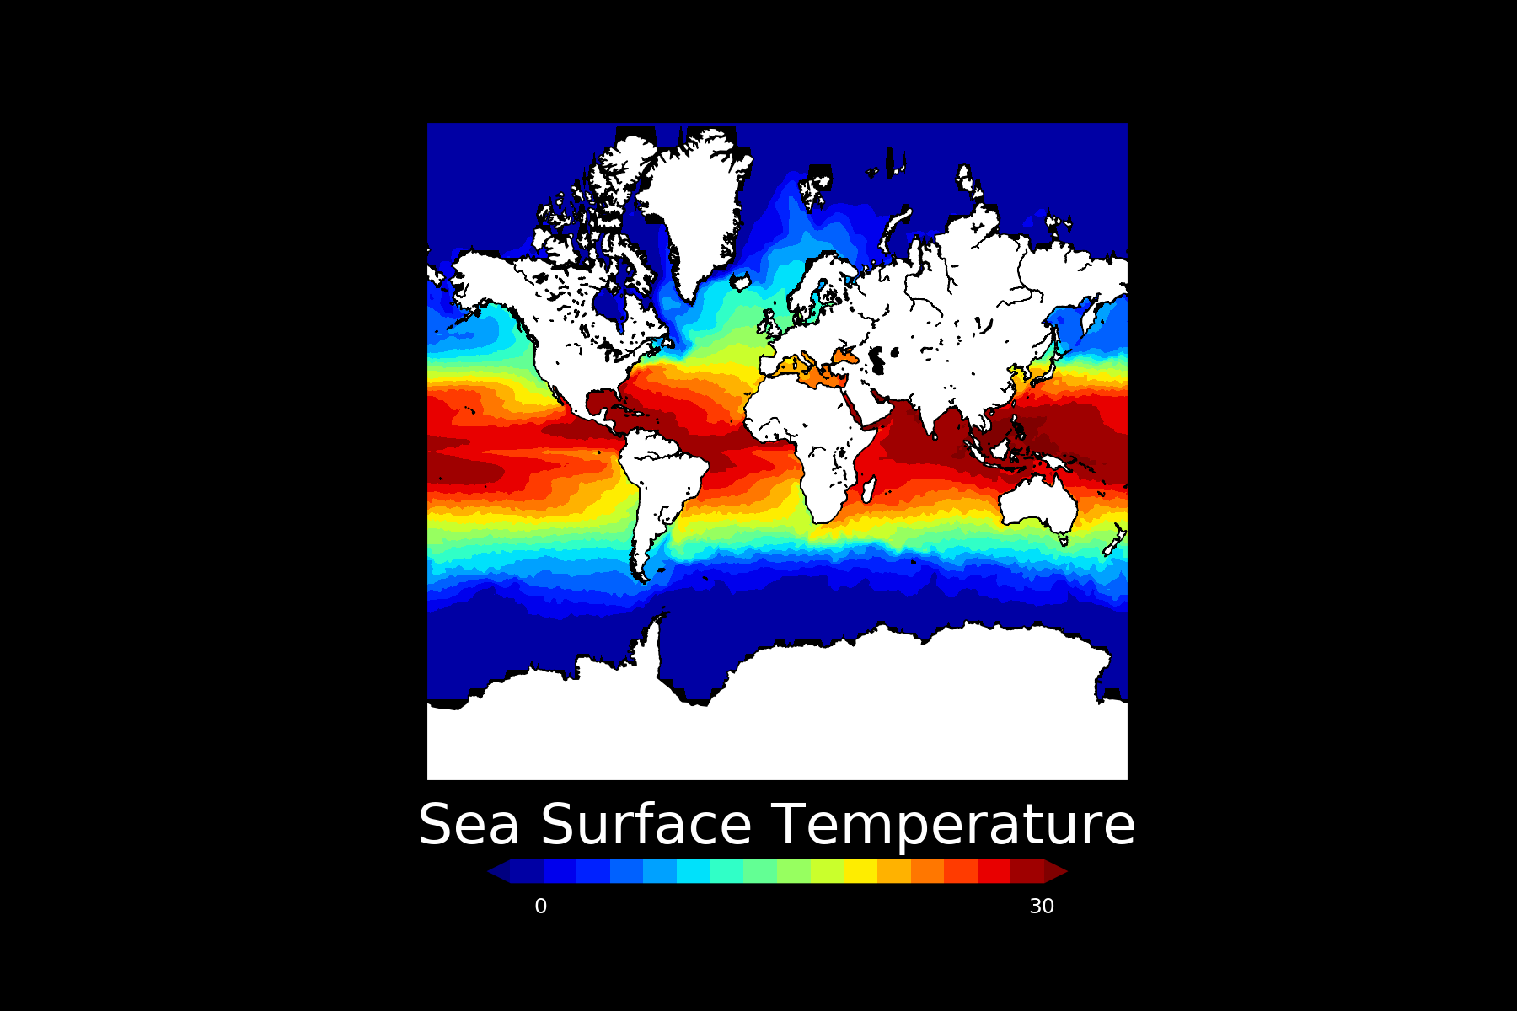
MAP PLOTS

Slide 18
YIKES – WHAT IS THIS MAP!

Slide 19
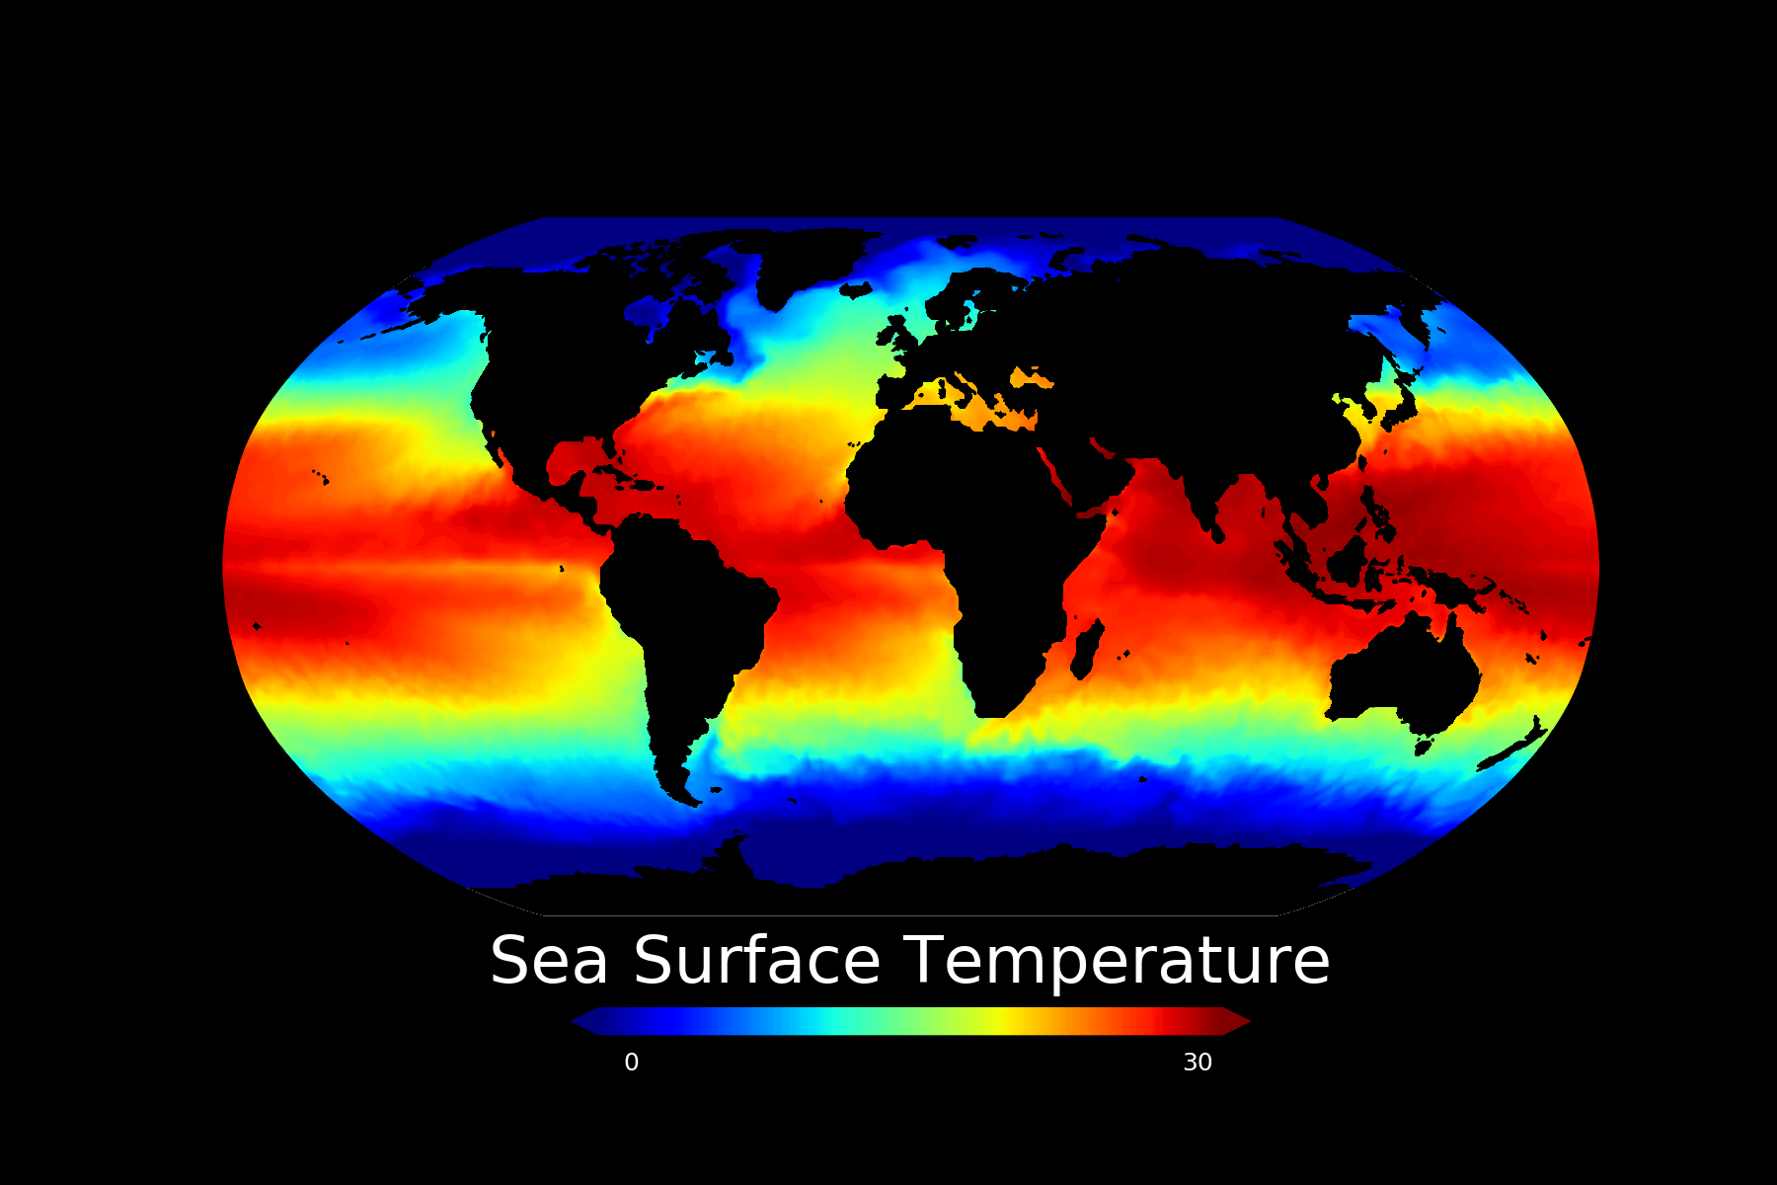
YIKES – FONT IS BLEH!

Slide 20

YIKES – COLOR!

Slide 21
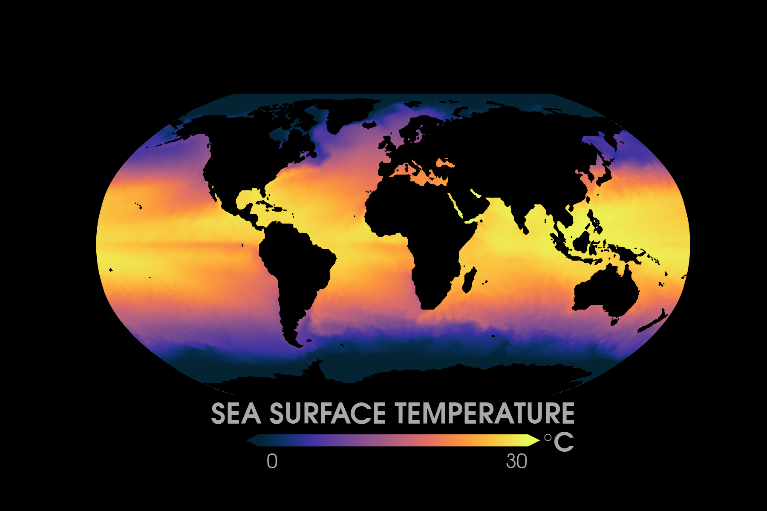
YIKES – MAP PROJECTION!

Slide 22
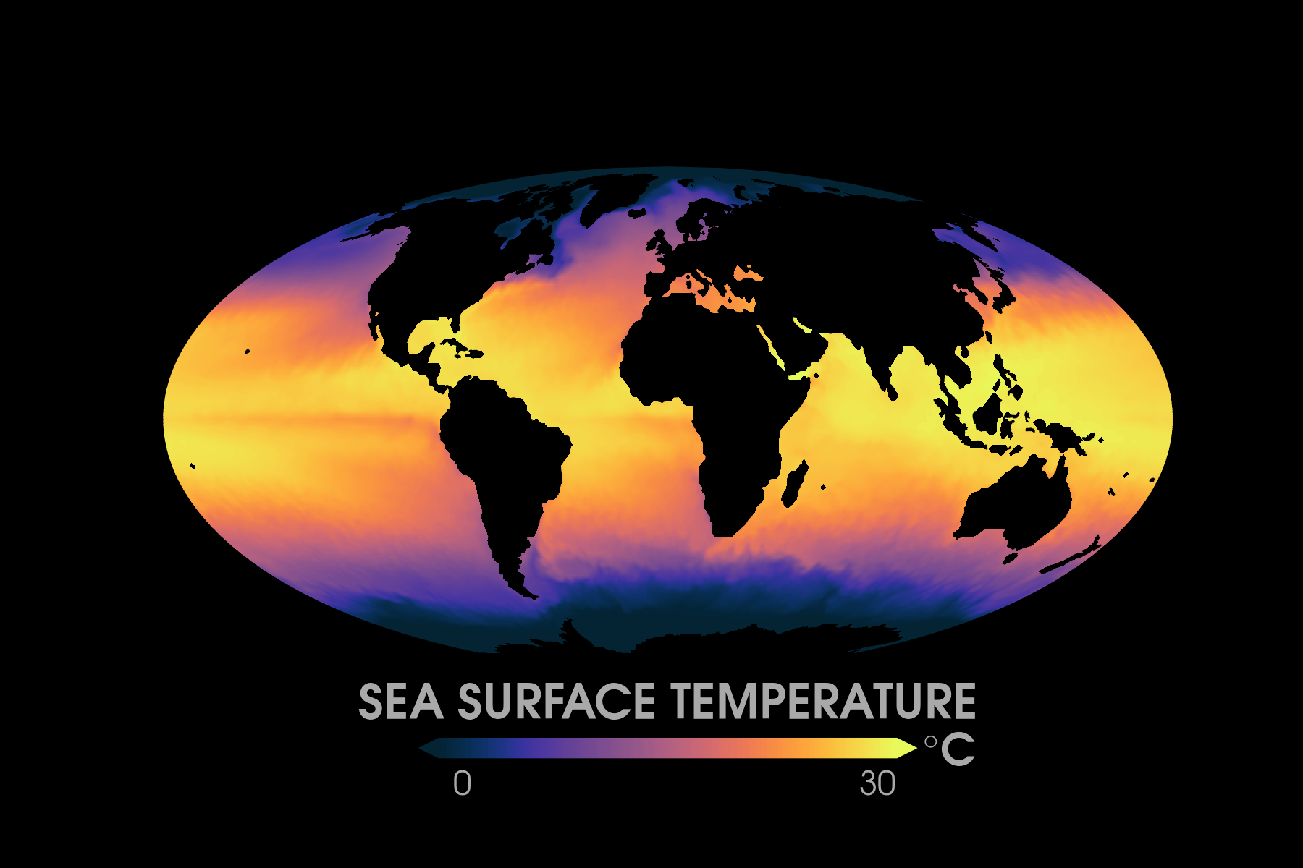
:)

Slide 23
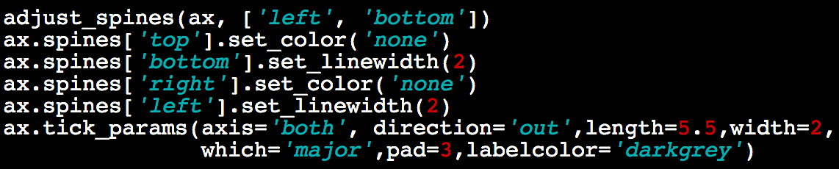
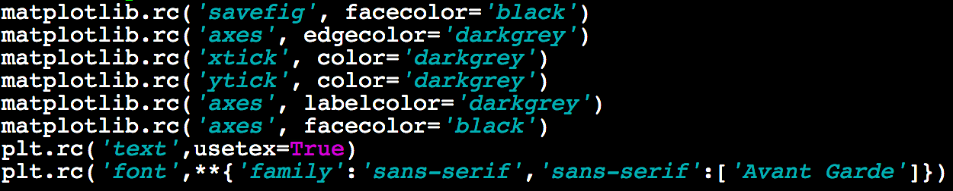
Adjusting axes (spines)

Slide 24
Changing font styles

Slide 25
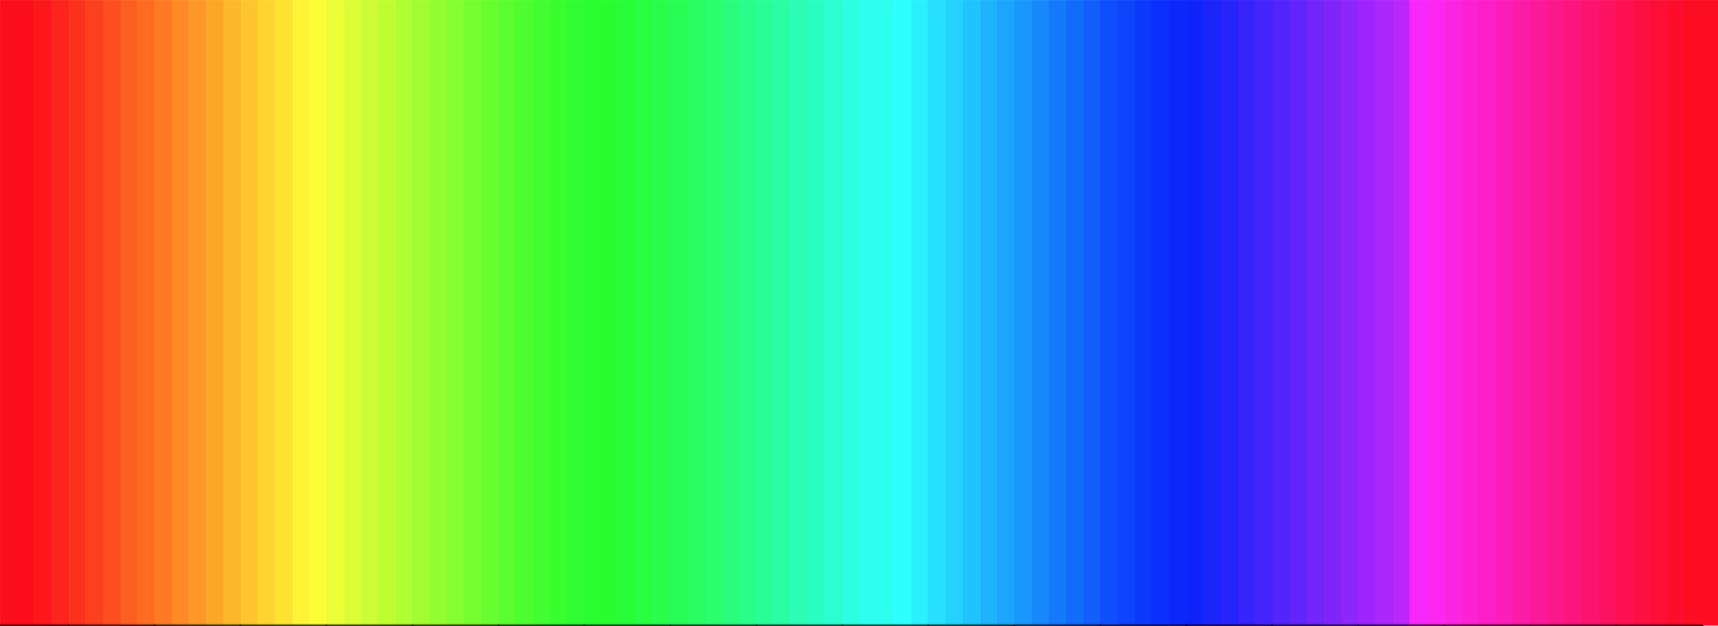
#endrainbow
Check out: https://betterfigures.org/2018/06/04/playing-hunt-the-discontinuity/

Slide 26

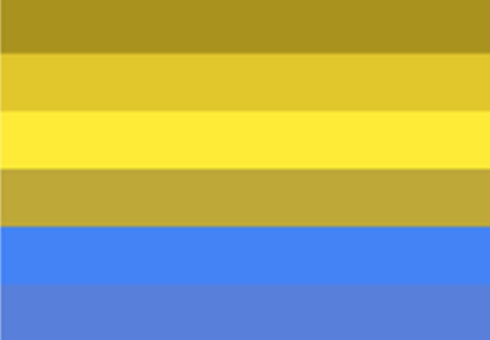
#endrainbow

Slide 27
#endrainbow

Slide 28
#endrainbow
Not all color-blind vision is the same!

Slide 29
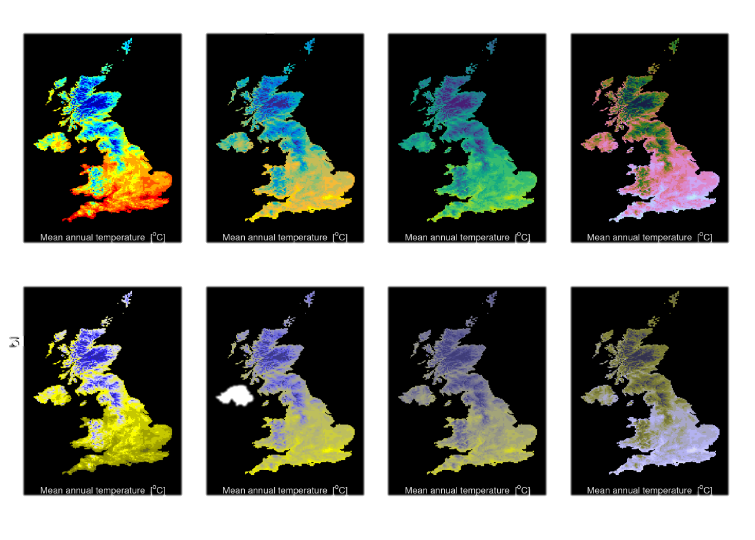
Adapted from Ed Hawkins at betterfigures.org

Slide 30
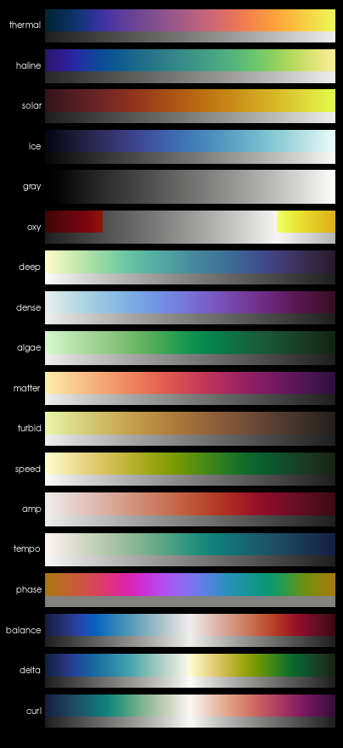
OTHER OPTIONS
THYNG ET AL. 2016; OCEANOGRAPHY

Slide 32
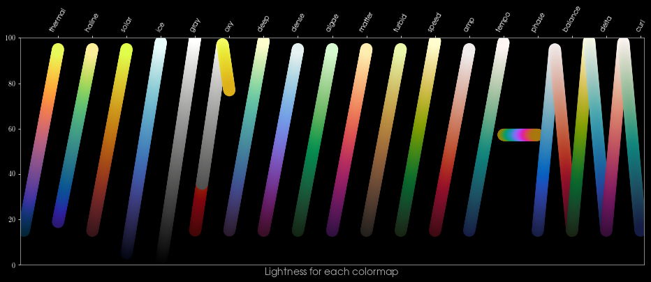
CMOCEAN

Slide 33
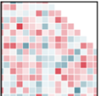
ALTERNATIVES
1. Seaborn. 2. Plotly. 3. ggplot. 4. Matplotlib v2.

Slide 34
PLOT BY ED HAWKINS

Slide 35
CHECK
Simple is best.
Color has meaning.
Data is visual.
PLOT BY ED HAWKINS

Slide 36
PLOT BY ED HAWKINS

